Slide 1
Sentiment Analysis of the Reviews of the Best MI Phone

Slide 2
Abstract
Mobile Phones are nowadays a very necessary thing for human being. There are lots of mobiles phones like MI, Lenovo, Realme, POCO, Samsung, Apple, Vivo, Oppo, Nokia, etc. While buying a mobile online, most of the users see the ratings and reviews given by the other users, so that it becomes easier for him or her to understand about the different features of the phone like heating issues, battery backup, screen touch, camera, sound, etc. All these data can be put to proper use to predict whether the phone is worth buying. This report aims at solving the problem of predicting whether the phone can be bought by identifying the important attributes from the data set and using the machine learning algorithms. I have limited my area of study to the reviews given by different users.
Sentiment analysis or opinion mining is the computational study of people’s emotions, opinions, sentiments by considering their reviews in the form of text. In recent years, this is the most active research area in the field of natural language processing and text mining. Since it is based on human opinion and influences the decision making capability of other humans, so its popularity is increasing day by day. The dataset that is used here comprise of online reviews of Redmi Note 5 Pro (all variants) collected from Flipkart.

Slide 3
Introduction
Natural Language Processing (NLP) is a field of artificial intelligence in which computers analyse, understand, and derive meaning from human language in a smart and useful way. By utilizing NLP, developers can organize and structure knowledge to perform tasks such as automatic summarization, translation, named entity recognition, relationship extraction, sentiment analysis, speech recognition, and topic segmentation.
By analysing language for its meaning, NLP systems have long filled useful roles, such as correcting grammar, converting speech to text and automatically translating between languages.
NLP is used to analyse text, allowing machines to understand how humans speak. This human-computer interaction enables real world applications like automatic text summarization, sentiment analysis, topic extraction, named entity recognition, parts-of-speech tagging, stemming and more. NLP is commonly used for text mining, machine translation, and automated question answering.

Slide 4
Project Scope
The scope of such a project work is getting customer reviews and ratings of the phone, which in return, shall yield benefits to the buyer who is thinking to buy that particular phone. The project work will focus on performing the various NLP techniques on the reviews, posted by the customers in the website.

Slide 5
Project Goal
The project aims at successfully understanding the likes and dislikes of the customers about the phone. The ultimate goal of such a project is predicting the impact of the phone on the customer, i.e., positive or negative.

Slide 6
Project Description
As MI phones are the most bought phones nowadays, so I thought of determining which Mi Phone, till date, is the best based on reviews and ratings from the users. Mostly, Mi Phones are available in Flipkart, so I have scraped the data from Flipkart of all the Mi Phones released till date. That data helped me in finding the best Mi Phone and finally I scraped all the reviews that were available on Flipkart.
From the final dataset, I will come across the best features of the phone, which features need any sort of improvement, whether the phone is worth buying, etc.

Slide 7
Dataset Understanding
The first data collected through scraping from Flipkart is about all the Mi Phones released till date. It has columns - Name of the Phone, it's color, RAM, Storage, Number of Ratings and Rating. From this data, we found out the best Mi Phone compared to all the other phones based on Rating and No. of Ratings.
After getting the name of the best Mi Phone, I have scraped all the reviews of the phone given by all the customers. So, in the final dataset, I have 19870 rows and 3 columns:
Review Header – short review of the phone.
Reviews – the description provided by the customers.
Rating – the rating that the customer has given.

Slide 8




Data Limitations
Number of Reviews → It was showing in Flipkart that Redmi Note 5 Pro with RAM 4GB has 123810 reviews but while scraping the reviews I found that it has 9930 reviews and rest of the review pages did not have any review. Picture below is the screenshot of the number of reviews in Flipkart:
And the next screenshot is the number of reviews that were scraped:
Similarly, for Redmi Note 5 Pro with RAM 6GB, it was showing in Flipkart that it has 25325 reviews. But while scraping I found that it has only 9940 reviews and the rest of the review pages were all blank. Picture below is the screenshot of the number of reviews in Flipkart:
And the next screenshot is the number of reviews that were scraped:

Slide 9
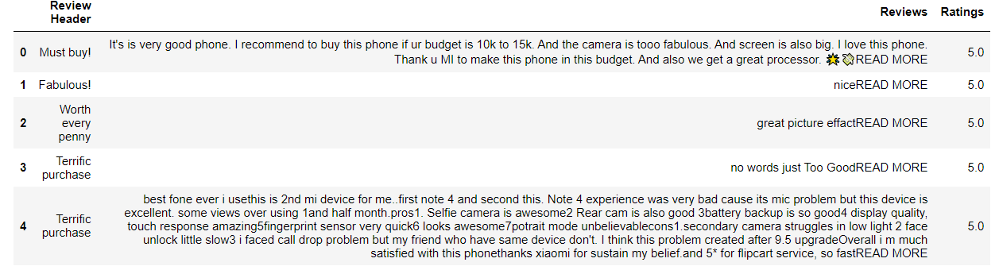
Data Limitations (Contd.)
Read More → While scraping the reviews of both Redmi Note 5 Pro with RAM 4GB and Redmi Note 5 Pro with RAM 6GB, for many reviews, the full review was not visible and there was a ‘Read More’ option on which I had to click and see the full review. This limitation was overcome by the below code snippet:
Even after I got to view the full review, the ‘Read More’ option was still coming. Below picture is the screenshot of this limitation:
To overcome this limitation, I had to replace the ‘Read More’ with a blank space. The screenshot of the code snippet is attached below:

Slide 10
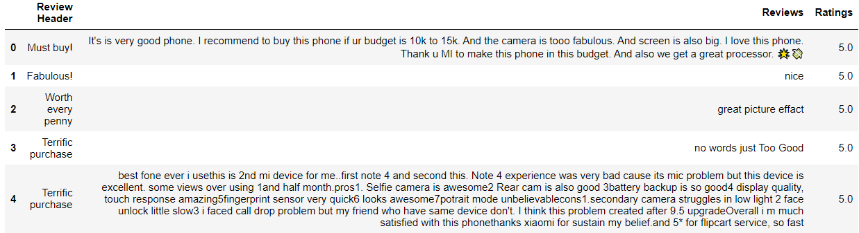
Data Limitations (Contd.)
Making of the real dataset → I had to concatenate the reviews of both Redmi Note 5 Pro with RAM 4GB and Redmi Note 5 Pro with RAM 6GB to make the dataset on which I worked on. Below picture is the screenshot of the dataset:

Slide 11
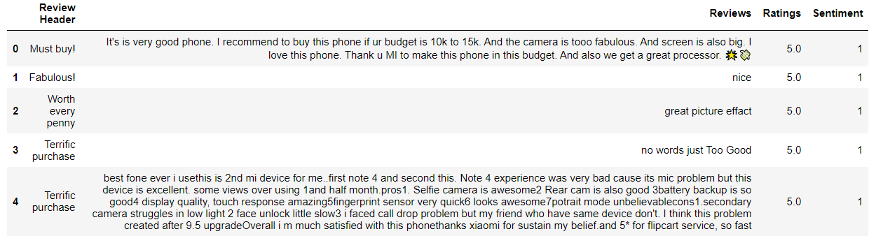
Exploratory Data Analysis
Checked if any null values are present.
There are duplicate values if we compare by the ‘Review Header’ column but their Reviews are different, so I cannot drop those duplicate values, otherwise, there will be loss of data.
On the basis of ‘Ratings’ column, I’ve derived one more column named as ‘Sentiment’ where:
If the rating given by the customer is 1, 2 or 3, then sentiment is 0.
If the rating given by the customer is 4 or 5, then sentiment is 1.
Below is the screenshot of the code snippet and the data frame:

Slide 12
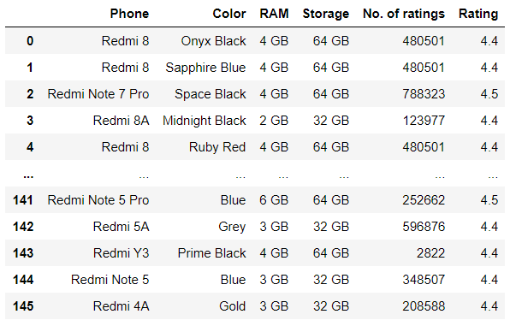
Data Collection
At first, I have scraped the Name of the Phone, it's color, RAM, Storage, Number of Ratings and Rating of all the Mi Phones from Flipkart, that have been released till date.

Slide 13
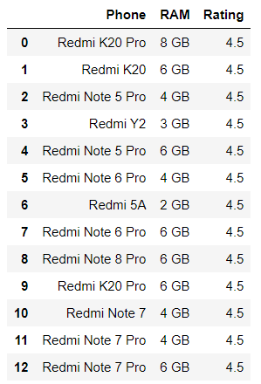
Data Collection (Contd.)
The screenshot shows the phones with the highest rating.

Slide 14
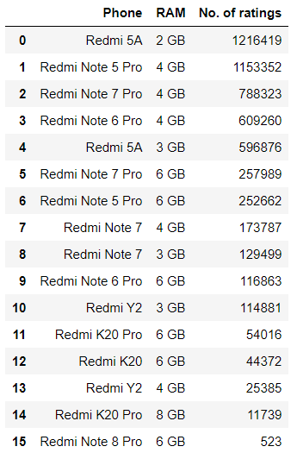
Data Collection (Contd.)
These phones have different variants, so I take the ‘No. of ratings’ column into account and found out which phone has the highest number of ratings based on their RAM.

Slide 15
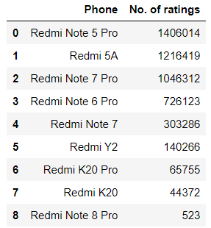
Data Collection (Contd.)
Summing up the number of ratings of each phone (all the variants) to get the best phone from the list.

Slide 16
As a result of the analysis, Redmi Note 5 Pro is the best phone based on Rating and Number of Ratings. Redmi Note 5 Pro has two variants: 4 GB RAM and 6 GB RAM. For further processing, I need the reviews of both the variants, so as to get the whole overview of Redmi Note 5 Pro.

Slide 17
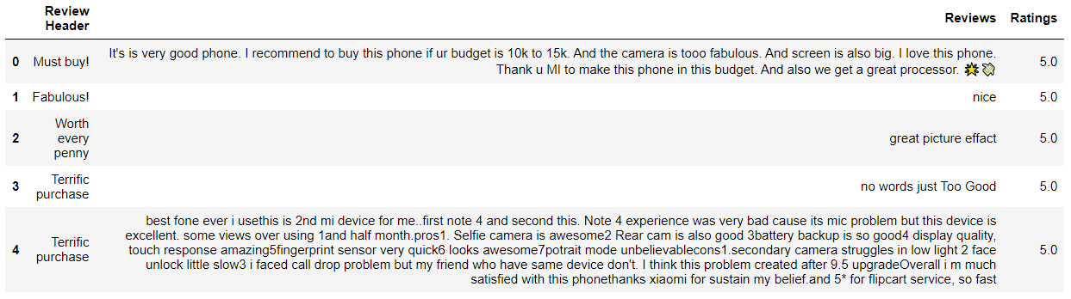
Data Collection (Contd.)
Now, I have scraped the reviews given by the users and ratings provided by those users who have given the reviews for Redmi Note 5 Pro of the variant 4 GB RAM, 64 GB Storage.

Slide 18
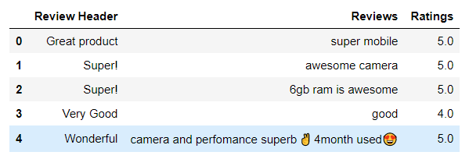
Data Collection (Contd.)
Then, I have scraped the reviews given by the users and ratings provided by those users who have given the reviews for Redmi Note 5 Pro of the variant 6 GB RAM, 64 GB Storage.

Slide 19

Data Collection (Contd.)
Lastly, concatenating the two data frames to get the whole data in a single data frame which will make it easier for me to process further.

Slide 20
Data Exploration
After getting the best Mi Phone, I started scraping the reviews of both Redmi Note 5 Pro with RAM 4GB and Redmi Note 5 Pro with RAM 6GB, wherein I got:
9930 reviews of Redmi Note 5 Pro with RAM 4GB.
9940 reviews of Redmi Note 5 Pro with RAM 6GB
Then I concatenated these two data to get a single data of:
Number of columns → 3
Names of columns → ‘Review Header’, ‘Reviews’, ‘Ratings’
Number of rows → 19870

Slide 21
Data Cleaning
Converting every character to lower case: There is no point in having both uppercase and lowercase characters in our data, it’s better to convert everything to lower case. Also, we need to make sure that no words are alphanumeric.
Removing Stopwords: The words like ‘this’, ‘there’, ‘that’, ‘is’, etc. do not provide very usable information and can create some useless clutter in our memory. Such words are called stopwords. It is okay to remove such words but it is advised to be cautious while doing so as words like ‘not’ are also considered as stopwords (this can be dangerous for tasks like sentiment analysis).
Removing Punctuations: Punctuations are of no use. These can be bad, as in, if we convert these into vectors, all they would do is take up memory space and increase the processing time without providing any valuable information about the text whatsoever. These need to be cleaned as well.
Removing emojis: Emojis are of no use. These are same as punctuations. These need to be cleaned as well, for the same reasons mentioned above for removal of punctuations.
Lemmatization: Lemmatization helps in keeping the words to its root form and it belongs to dictionary words form and therefore doesn’t cut off the words’ suffixed letters. It also helps in retaining the original meaning unlike Stemming which removes the suffixes to get the word to its root form and it gets rid of the meaningful form of the word. But as we are dealing with mobile reviews and to get hold of the customer eccentric area, the word needs to be in its precise form so that we can get the meaningful words and analyze depending on that. Therefore, I have chosen the Lemmatization method instead of Stemming, even though it gives me more number of words, but the meaning of the words would remain intact.

Slide 22
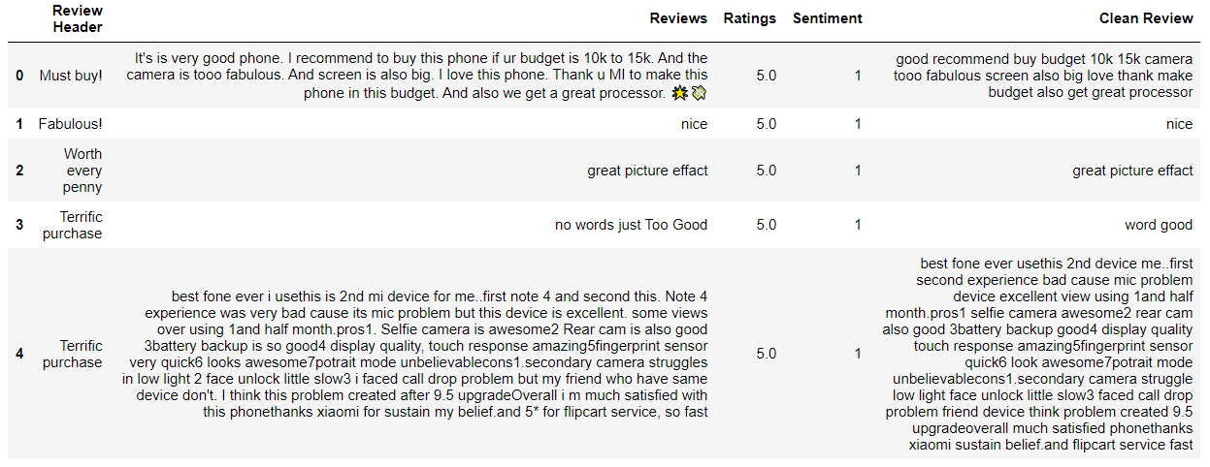
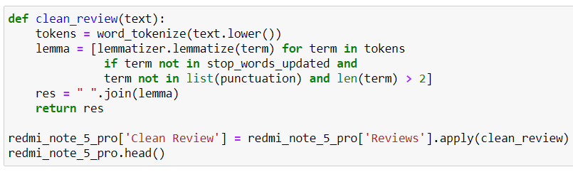
Data Cleaning (Contd.)
The screenshots of the code snippet of cleaning the reviews and the dataset after the reviews are cleaned:

Slide 23
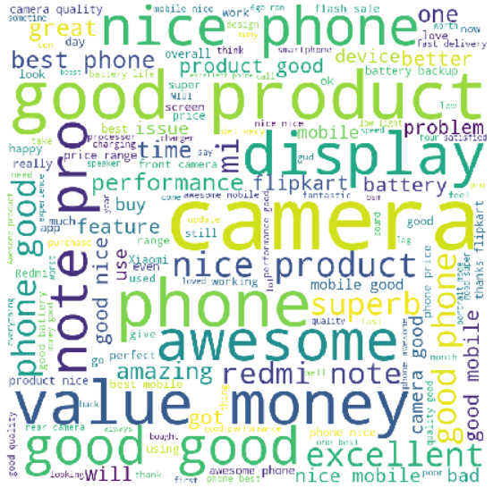
Data Visualization
Before cleaning the reviews, combined all the reviews and prepared a Word Cloud of top 150 words. Below picture is the screenshot of the Word Cloud:

Slide 24
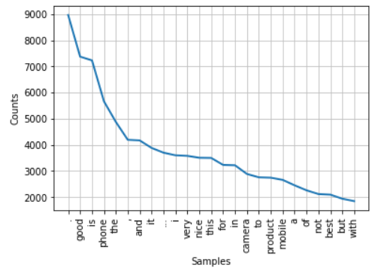
Data Visualization (Contd.)
Found out the number of occurrences of the top 25 words. Below is the screenshot:

Slide 25
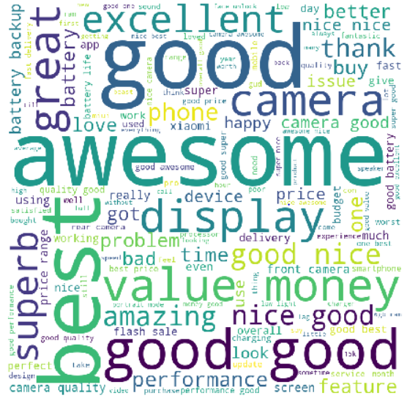
Data Visualization (Contd.)
After cleaning the reviews, combined all the reviews and prepared a Word Cloud of top 150 words. Below is the screenshot:

Slide 26
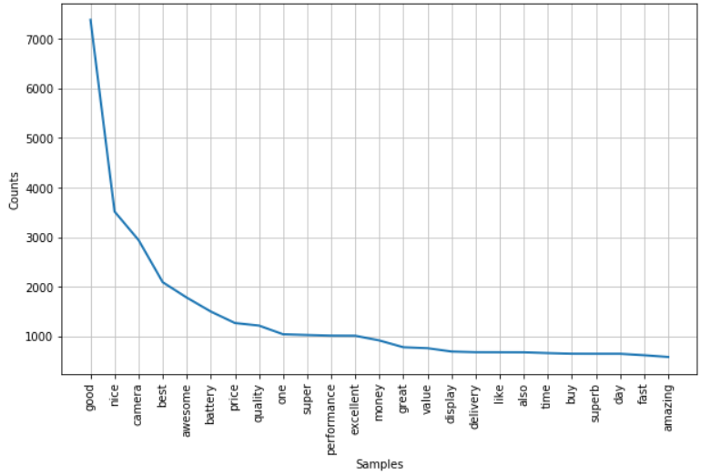
Data Visualization (Contd.)
Found out the number of occurrences of the top 25 words. Below is the screenshot:

Slide 27
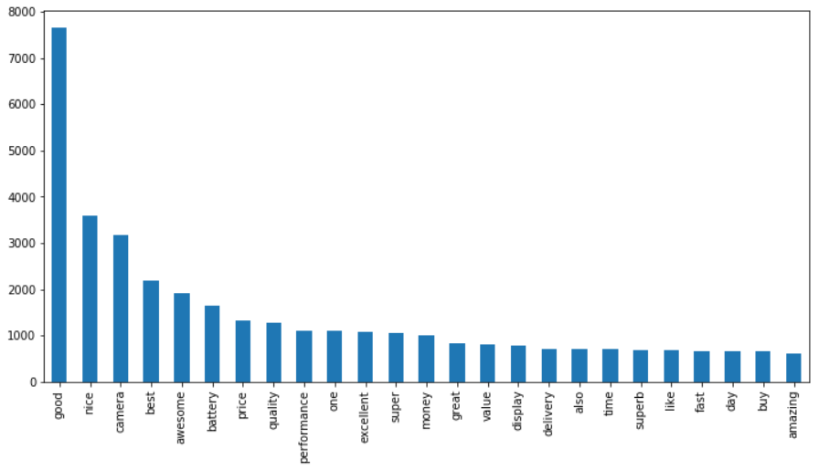
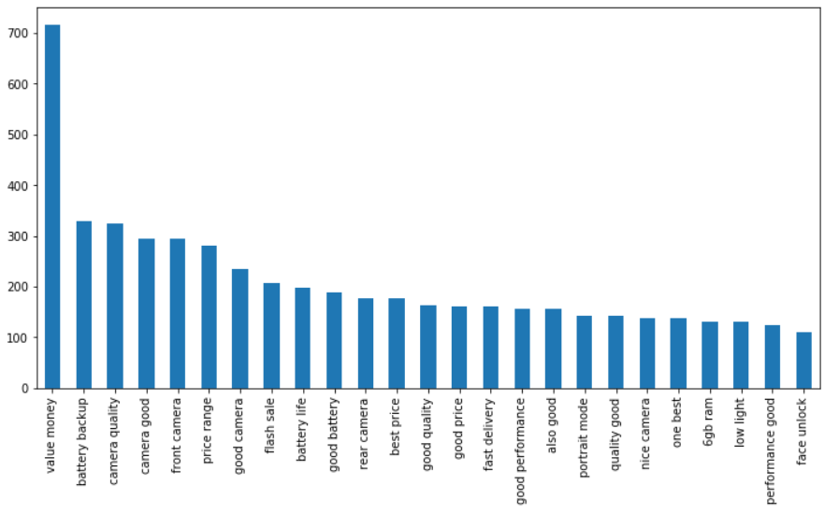
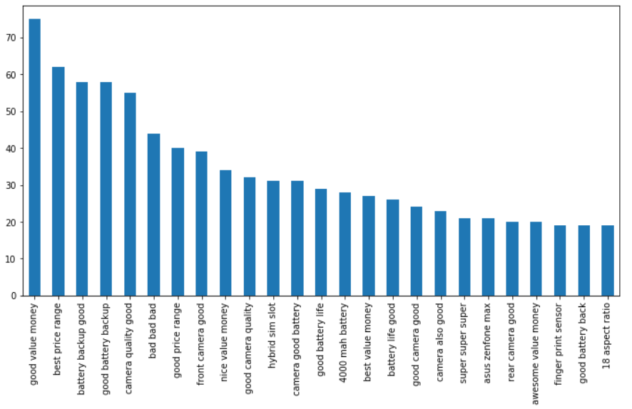
Data Visualization (Contd.)
Then I have performed n-gram Analysis and found the top 25 unigram, top 25 bigram and top 25 trigram. Below are the screenshots:

Slide 28
Feature Engineering
While performing n-gram Analysis, I have used Count Vectorizer. Count Vectorizer is used to convert a collection of text documents to a vector of term/token counts. It also enables the ​pre-processing of text data prior to generating the vector representation. This functionality makes it a highly flexible feature representation module for text. I have taken maximum features as 25 words for performing all Unigram, Bigram and Trigram analysis.
Whereas, the TF-IDF Vectorizer will tokenize documents, learn the vocabulary and inverse document frequency weightings, and allow us to encode new documents.
The only difference is that, the TfidfVectorizer() returns ‘float’ values while the CountVectorizer() returns ‘int’ values. TfidfVectorizer() assigns a score while CountVectorizer() counts.
This is the reason why I chose to perform n-gram analysis using Count Vectorizer.

Slide 29
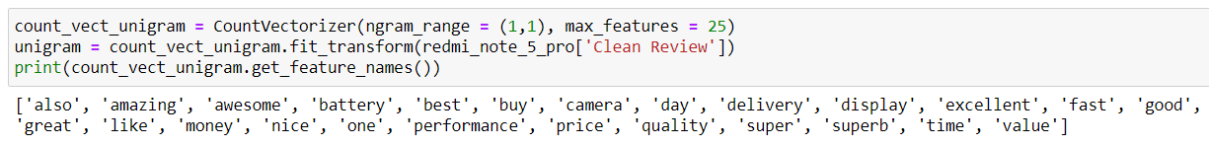
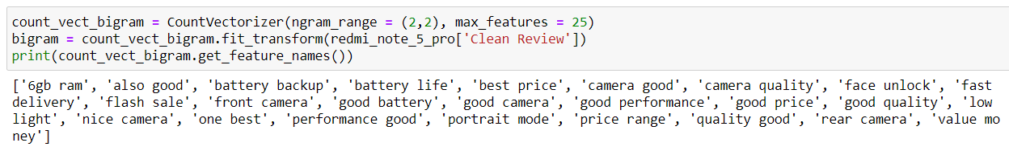
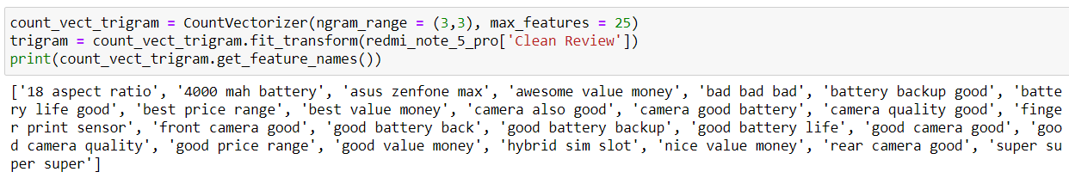
Feature Engineering (Contd.)
Below are the screenshots of the code snippets along with the outputs of top 25 most used words in Unigram, Bigram and Trigram Analysis:

Slide 30
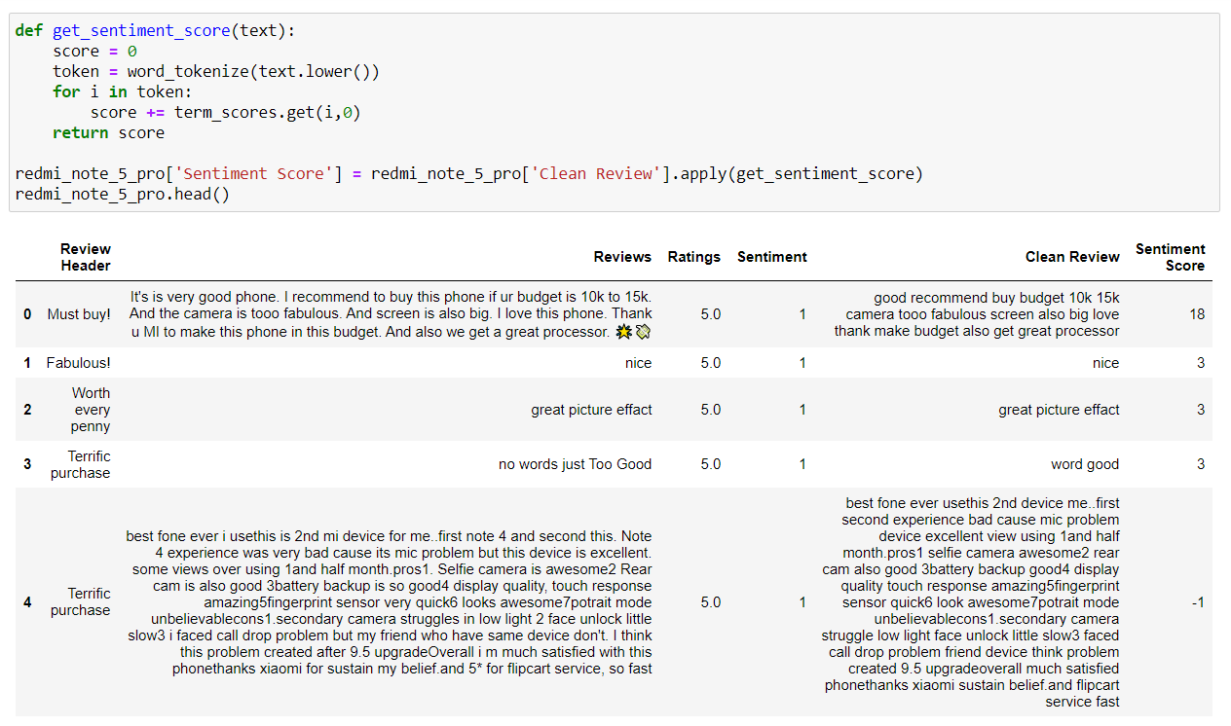
Sentiment Prediction
For predicting the sentiment of a review, at first, I have used the afinn-111.txt file to get the sentiment score of the terms that are present in that file. Then, I calculated the sentiment score of each cleaned review. Below is the screenshot of the code snippet and its output:

Slide 31
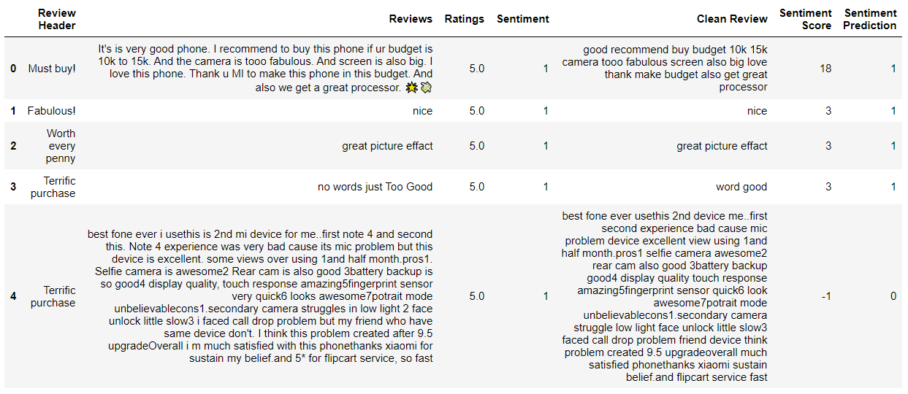
Sentiment Prediction (Contd.)
After this I got the sentiment prediction of each review stating when the ‘sentiment score’ is less than 0, ‘sentiment prediction’ will be 0 and when the ‘sentiment score’ is greater than 0, ‘sentiment prediction’ will be 1. Below is the screenshot of the code snippet and its output:

Slide 32
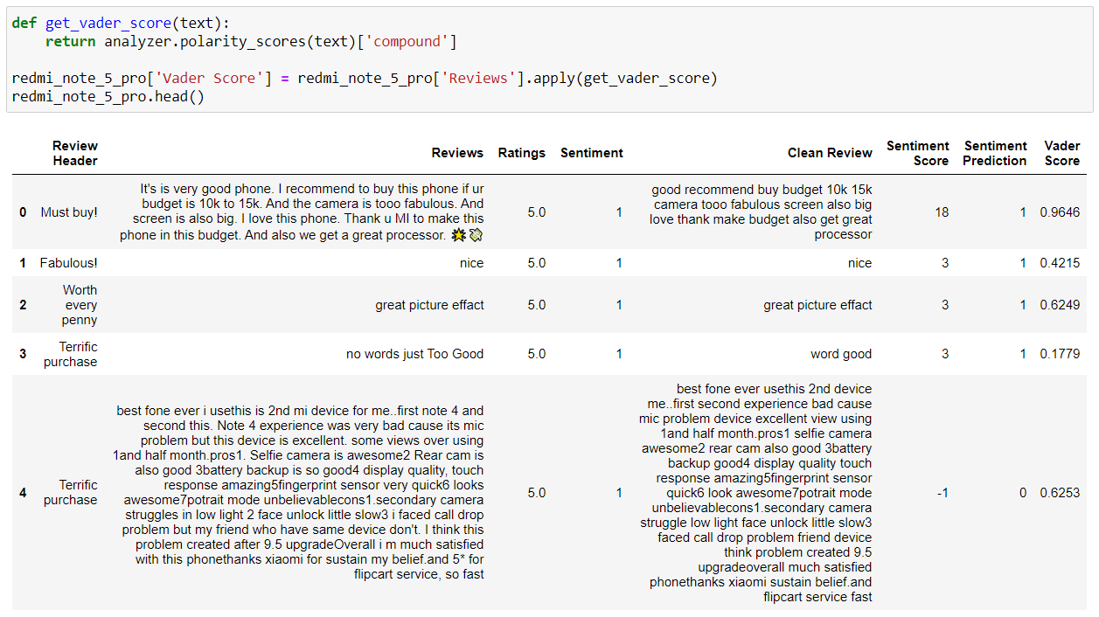
VADER Prediction
VADER (‘V’alence ‘A’ware ‘D’ictionary and s’E’ntiment ‘R’easoner) is a lexicon and rule-based sentiment analysis tool that is specifically attuned to sentiments expressed in social media. VADER uses a combination of A sentiment lexicon is a list of lexical features (e.g., words) which are generally labelled according to their semantic orientation as either positive or negative. VADER not only tells about the positivity and negativity score but also tells us about how positive or negative a sentiment is. It is also known as Compound Value.
At first, I have found the vader score of all the uncleaned reviews. Below is the screenshot of the code snippet and its output:

Slide 33
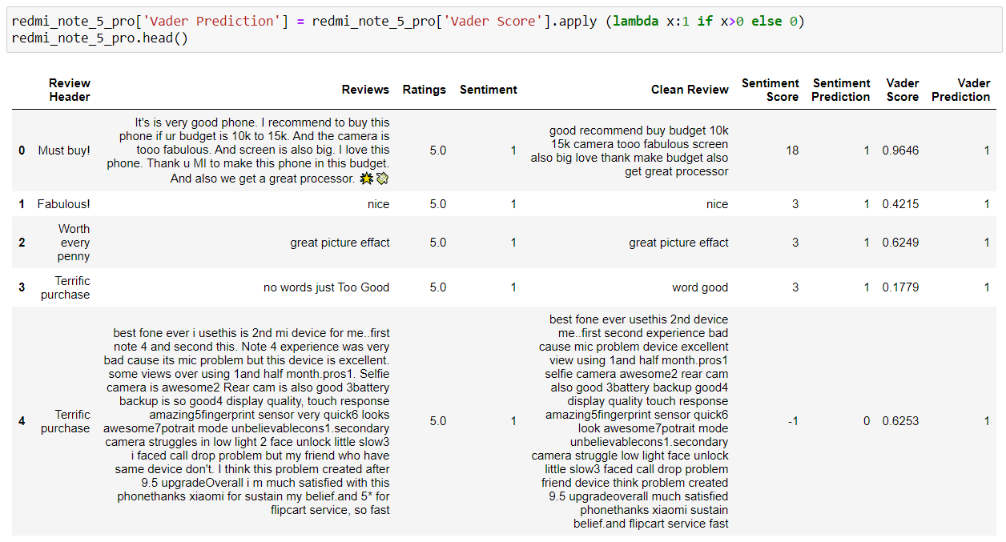
VADER Prediction (Contd.)
Vader score lies between -1 and 1. Now, based on the vader scores, I got the vader predictions. If the vader score is less than 0, then vader prediction will be 0 and if the vader score is greater than 0, then vader prediction will be 1. Below is the screenshot of the code snippet and its output:

Slide 34
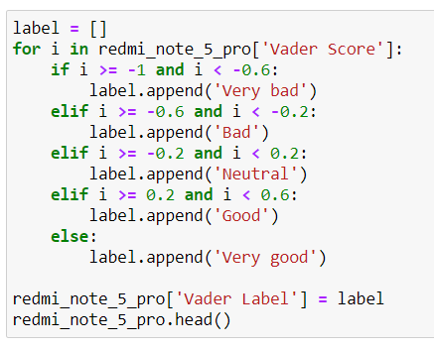
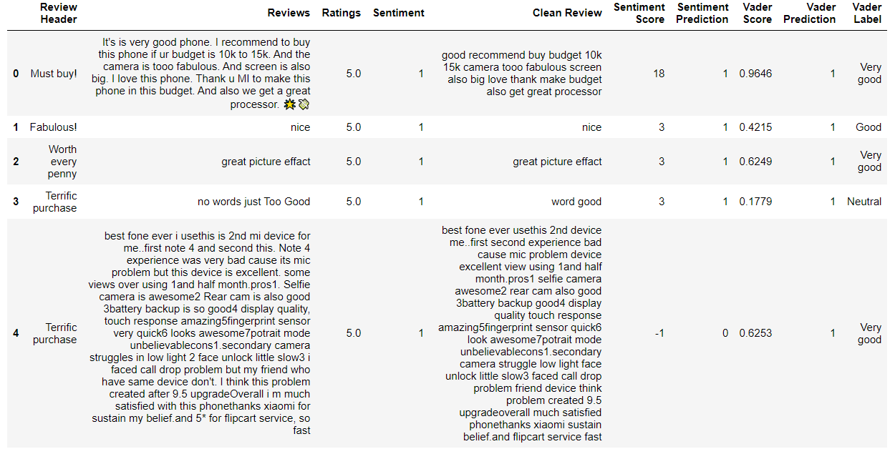
VADER Prediction (Contd.)
Next, based on the vader scores, I have classified all the reviews. Below is the screenshot of the code snippet and its output:

Slide 35
Model Building
Among many of the machine learning models for sentiment classification, I have used Logistic Regression and Gaussian Naïve Bayes algorithms.
Logistic Regression → Logistic regression is a classification algorithm used to assign observations to a discrete set of classes. Unlike linear regression which outputs continuous number values, logistic regression transforms its output using the logistic sigmoid function to return a probability value which can then be mapped to two or more discrete classes.
Naïve Bayes → It is a classification technique based on Bayes’ Theorem with an assumption of independence among predictors. In simple terms, a Naive Bayes classifier assumes that the presence of a particular feature in a class is unrelated to the presence of any other feature. It is of three types:
Gaussian → It is used in classification and it assumes that features follow a normal distribution.
Multinomial → It is used for discrete counts.
Bernoulli → It is used when the feature vectors are binary.
I checked the accuracy of both Logistic Regression model and Gaussian Naïve Bayes model using both Count Vectorizer and TFIDF Vectorizer.

Slide 36
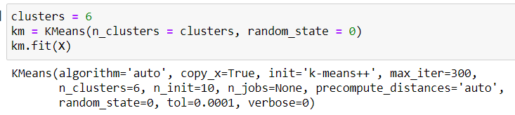
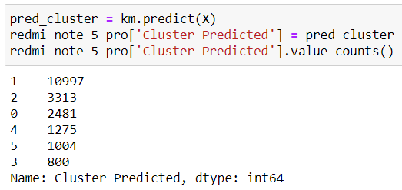
Clustering
Clustering is the process of dividing the entire data into groups (also known as clusters) based on the patterns in the data. I have used KMeans Clustering here and classified the cleaned reviews into 6 clusters.
Then predicted, how many words belong to each cluster.

Slide 37
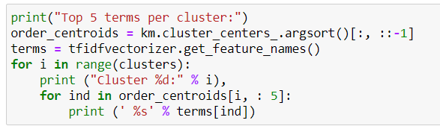
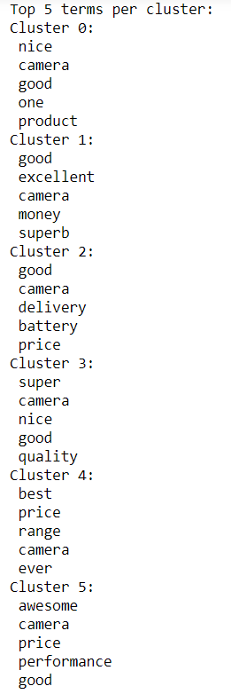
Clustering (Contd.)
Lastly, I found out the top 5 words of each cluster. Below is the screenshot of the code snippet and its output:

Slide 38
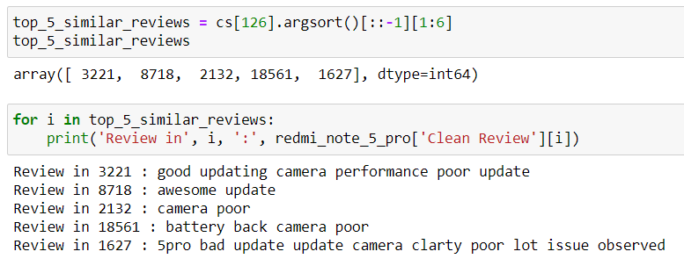
Cosine Similarity
Cosine similarity is a metric used to determine how similar the documents are irrespective of their size. Using Cosine Similarity, I found out the similar types of reviews, similar types of words, etc. Here, I have used Cosine Similarity to come up with top 5 similar reviews with respect to a review randomly taken. Below is the screenshot of the randomly taken review:
Below is the screenshot of the code snippet and the output of top 5 similar reviews with respect to the above review:

Slide 39
Evaluation
I have evaluated my techniques and models with the help of accuracy score.
After performing Sentiment Analysis, I got an accuracy of:
After performing Vader Analysis, I got an accuracy of:

Slide 40
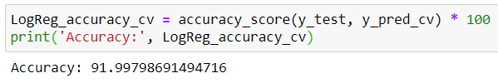



Evaluation (Contd.)
Then I started building model. I had built two models, Logistic Regression and Gaussian Naïve Bayes, both using Count Vectorizer and TFIDF Vectorizer.
Building Logistic Regression model using Count Vectorizer gave an accuracy of:
Building Logistic Regression model using TFIDF Vectorizer gave an accuracy of:
Applying Gaussian Naïve Bayes algorithm and building a model using Count Vectorizer gave an accuracy of:
Applying Gaussian Naïve Bayes algorithm and building a model using TFIDF Vectorizer gave an accuracy of:

Slide 41
What worked
Sentiment Prediction worked fluently for me on the full dataset with a pretty decent accuracy of nearly 83%.
Vader prediction also worked flawlessly on the full dataset with a good accuracy of around 84.5%.
Then I had built Logistic Regression model using Count Vectorizer on the dataset which also worked really good for me with an accuracy of nearly 92% and using TFIDF Vectorizer, I got accuracy of around 91.4%.
Next, I performed KMeans Clustering and Cosine Similarity, which worked really well for the dataset.

Slide 42
What didn’t work
I had built one more model with Gaussian Naïve Bayes algorithm using Count Vectorizer with an accuracy of around 24.4%, which was really not good for the dataset and using TFIDF Vectorizer, I got an accuracy of around 25.9% which was also not at all decent for the dataset. So, I would say, this didn’t work well for the dataset.
I couldn’t find the Customer Concern Areas for the full dataset, as it needs way more high specification to process. So, I had to use max features function and on those features I found out the customer concern areas.

Slide 43
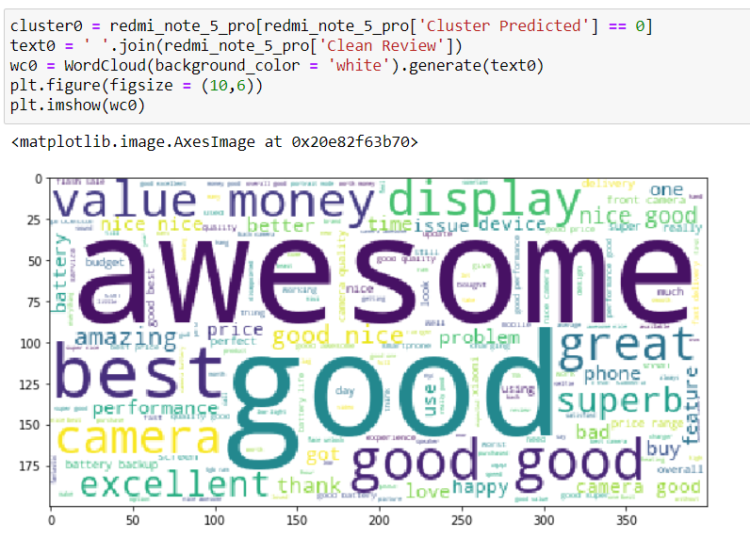
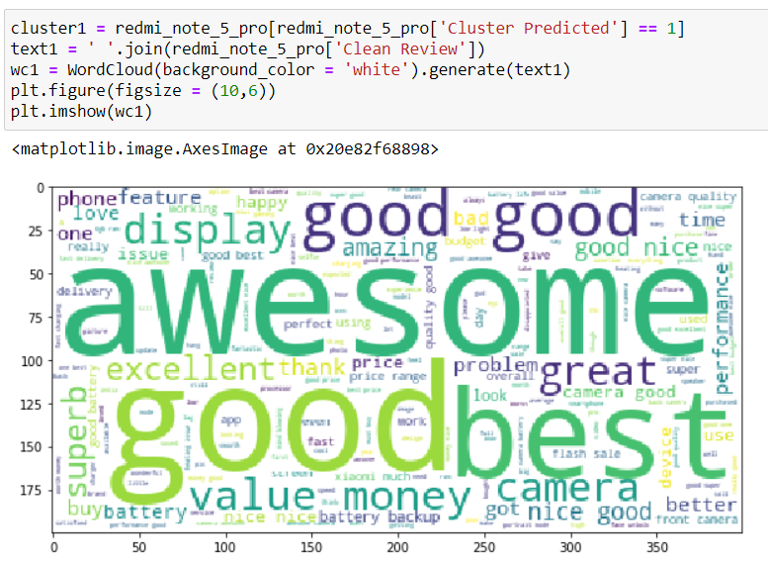
Output of the intermediate steps
Using Cosine Similarity, I found out how many words are there in each cluster. I have used max features as 150 to make a word cloud of all the clusters. Below are the code snippets along with the outputs of the first two clusters:

Slide 44
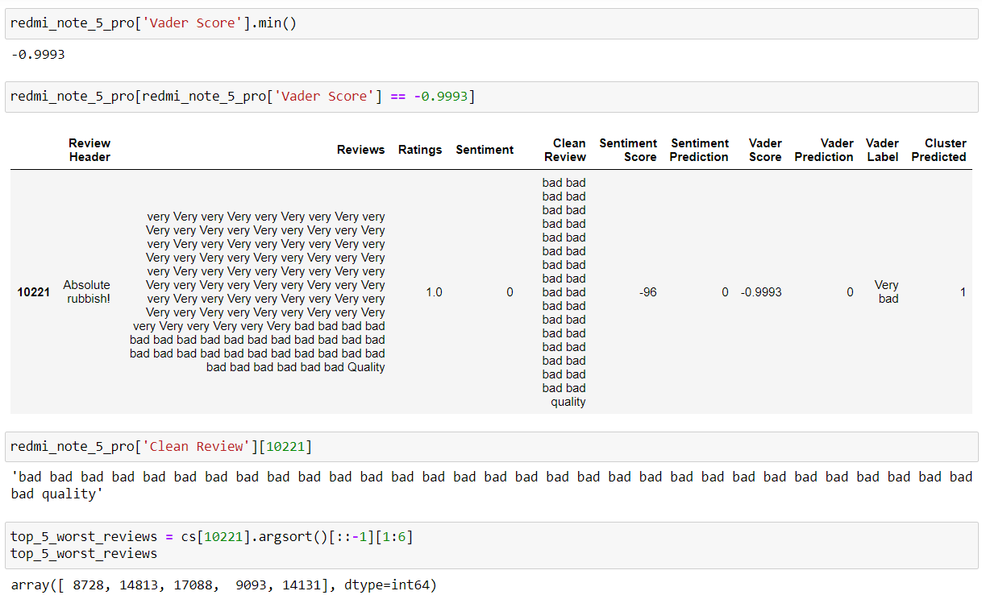
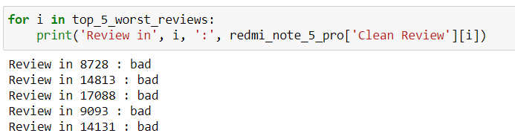
Output of the intermediate steps (Contd.)
Using Cosine Similarity, I have found out the top 5 similar reviews for the review with the least polarity score.

Slide 45
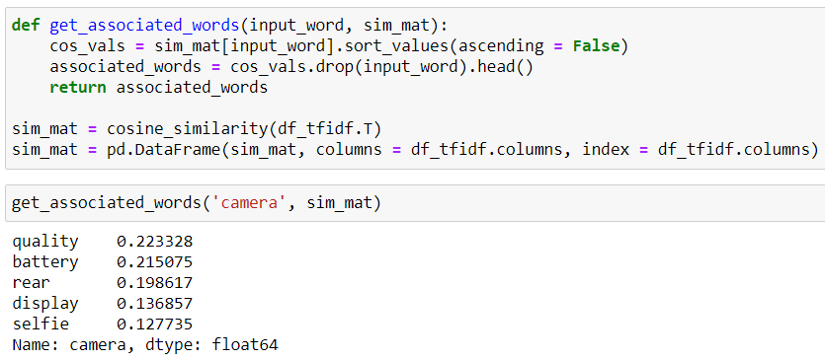
Output of the intermediate steps (Contd.)
Using Cosine Similarity, I have found out the top 5 associated words with respect to a word.

Slide 46
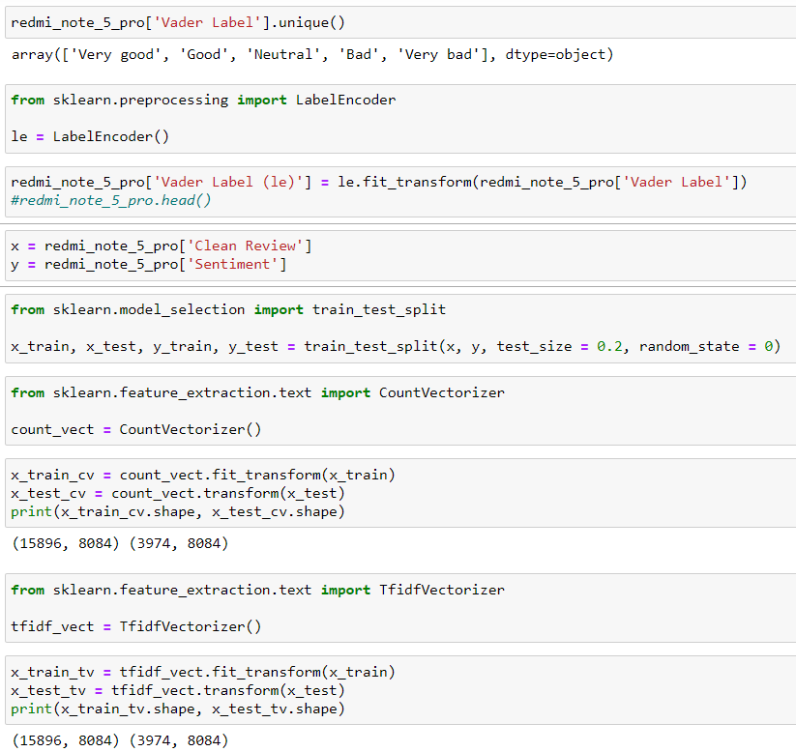
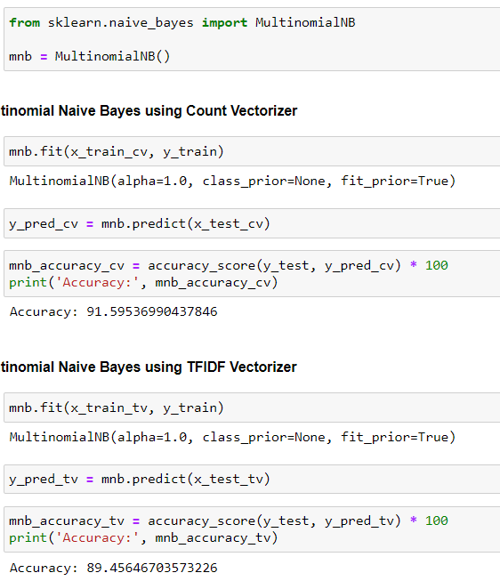
Output of the intermediate steps (Contd.)
Using the vader labels to build a multi-class classification model to predict the accuracy of a customer review with the help of Multinomial Naïve Bayes algorithm.

Slide 47
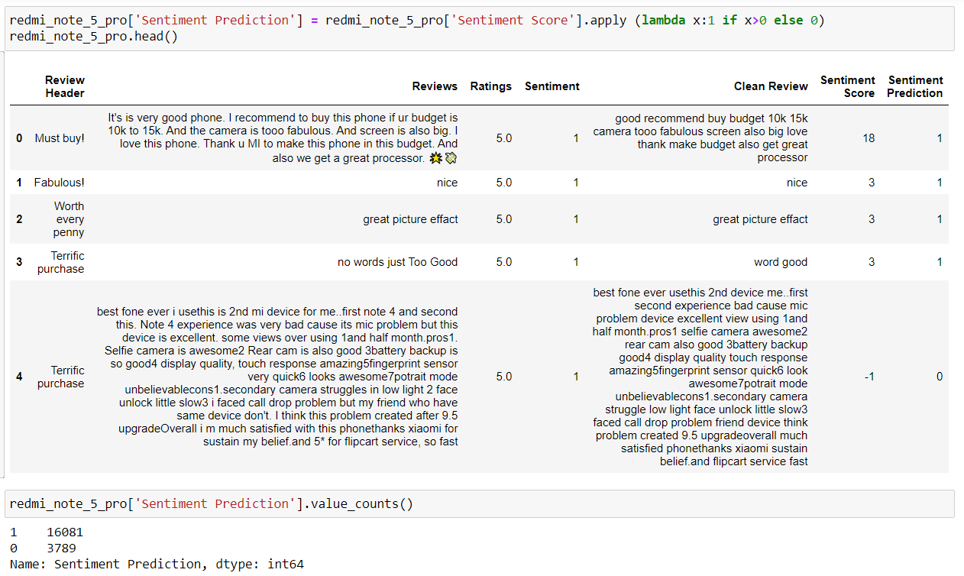
Final Outcome / Sample Output
Sentiment Prediction based on the cleaned reviews.

Slide 48
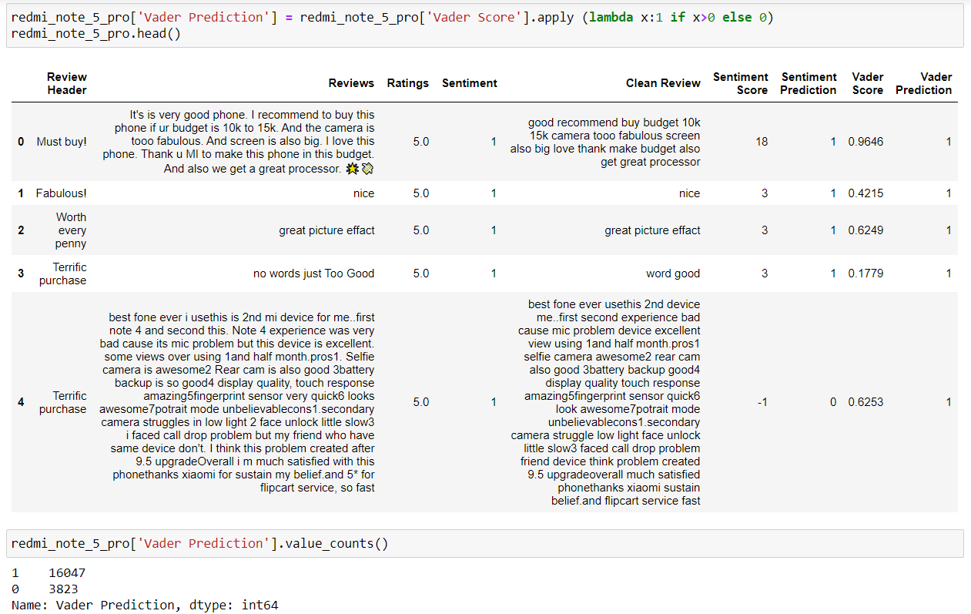
Final Outcome / Sample Output (Contd.)
Impact of the phone on the customer, i.e., positive or negative. This can be identified by the Vader Prediction.

Slide 49
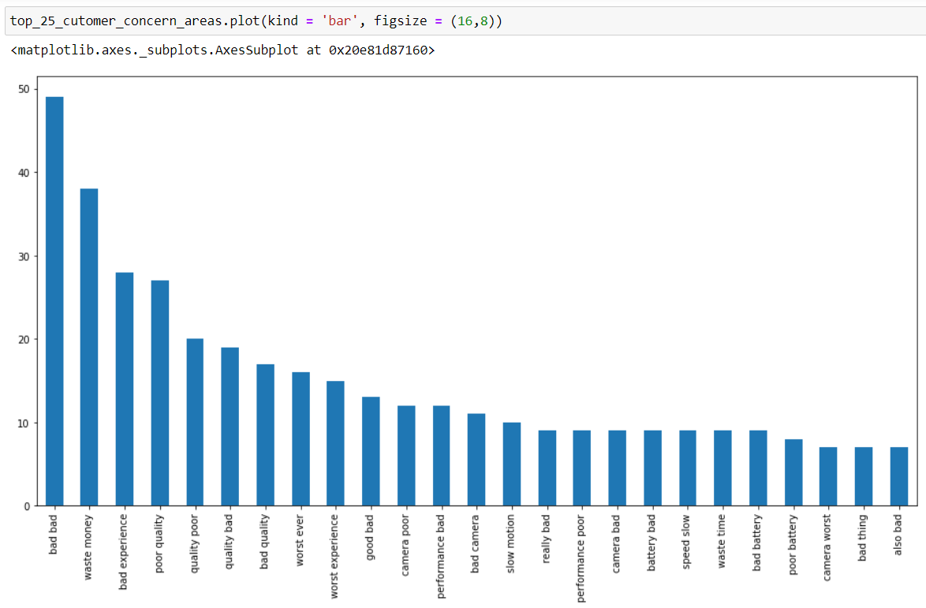
Final Outcome / Sample Output (Contd.)
Improvement areas of the phone based on the customer reviews and their likes & dislikes about the phone. This can be judged from the Customer Concern Areas.

Slide 50
Analysis of the Results
From Sentiment Prediction we can say that, most of the reviews are positive for this phone and a very a smaller number of reviews are negative.
The impact of the phone to most of the customers are positive and negative to a very a smaller number of customers. This has been predicted through Vader Analysis.
Few customers have issues with the quality, camera, performance, battery and speed. But this number of customers are very less compared to who have positive impact on the phone. So, keeping in mind about the reviews of the customers those who have faced issues with the phone, these are the improvement areas of the phone.
We have evaluated our Sentiment Analysis classifier on the dataset and we were able to observe that Logistic Regression model performed well on the dataset, whereas, Gaussian Naïve Bayes performed very poorly.

Slide 51
Conclusion
With the variety of products increasing day by day the decision to opt for a particular product is becoming difficult. So, the need for sentimental analysis is increasing gradually. Although sentimental analysis tasks are challenging due to their natural language processing origins, much progress has been made over the last few years due to the high demand for it. Not only the consumer wants to know about the product but also the companies want to know about the condition of their product in the market.
The growing need for product insights – and the technical challenges currently facing the field –will keep sentiment analysis and opinion mining relevant for the foreseeable future. Next-generation opinion mining systems need a deeper bind between complete knowledge bases with reasoning methods inspired by human thought and psychology. This will lead to a better understanding of natural language opinions and will more efficiently bridge the gap between unstructured information in the form of human thoughts and structured data that can be analysed and processed by a machine.
Sentiment analysis or opinion mining is a field of study that analyses people’s sentiments, attitudes, or emotions towards certain entities. This project tackles a fundamental problem of sentiment analysis, sentiment polarity categorization. Online Redmi Note 5 Pro reviews from Flipkart are selected as data used for this study.
In this project, we illustrated that the Logistic Regression model performed better than Gaussian Naïve Bayes with our dataset and thus is broadly applicable in the growing areas of sentiment analysis and retrieval. We can come to a conclusion that this phone can be bought by the customers as most of the reviews are positive and impact on most of the customers are also positive.

Slide 52
References
https://towardsdatascience.com/getting-your-text-data-ready-for-your-natural-language-processing-journey-744d52912867
https://monkeylearn.com/sentiment-analysis/
https://www.researchgate.net/publication/273532029_Sentiment_Analysis_on_Reviews_of_Mobile_Users
http://cs229.stanford.edu/proj2014/Vikram%20Elango,%20Govindrajan%20Narayanan,%20Sentiment%20Analysis%20for%20Hotel%20Reviews.pdf
https://journalofbigdata.springeropen.com/articles/10.1186/s40537-015-0015-2
https://ukdiss.com/examples/0019529.php
https://www.machinelearningplus.com/nlp/cosine-similarity/
https://www.analyticsvidhya.com/blog/2019/08/comprehensive-guide-k-means-clustering/
https://www.analyticsvidhya.com/blog/2017/09/naive-bayes-explained/#:~:text=Naive%20Bayes%20Model-,What%20is%20Naive%20Bayes%20algorithm%3F,presence%20of%20any%20other%20feature.
https://ml-cheatsheet.readthedocs.io/en/latest/logistic_regression.html

